Slide 1
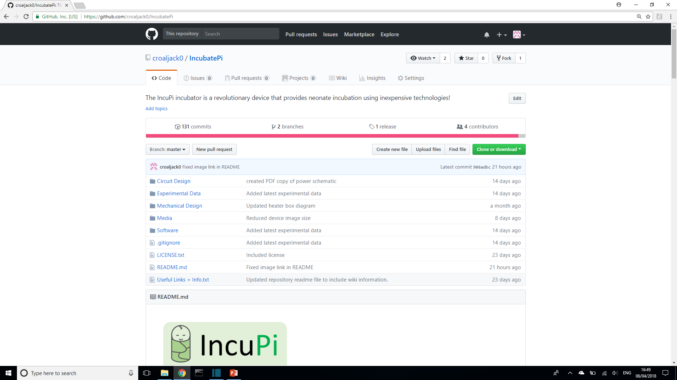


For more information:
Follow IncuPi on and
Find our GitHub repository for source code
and device construction:
https://github.com/croaljack0/IncubatePi

